Slide 1
Section 5.3: Address Resolution Protocol
Upon completion of this section, you should be able to:
Compare the roles of the MAC address and the IP address.
Describe the purpose of ARP.
Explain how ARP requests impact network and host performance.
Notes:
5.3

Slide 2
Topic 5.3.1: MAC and IP

Slide 3
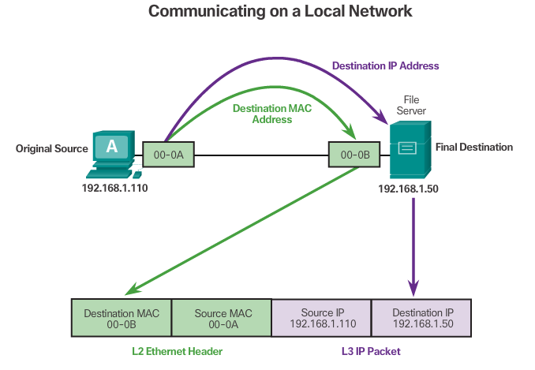
Destination on the Same Network
There are two primary addresses assigned to a device on an Ethernet LAN:
Physical address (the MAC address) – Used for Ethernet NIC to Ethernet NIC communications on the same network.
Logical address (the IP address) – Used to send the packet from the original source to the final destination.
Notes:
5.3.1.1 Destination on Same Network

Slide 4
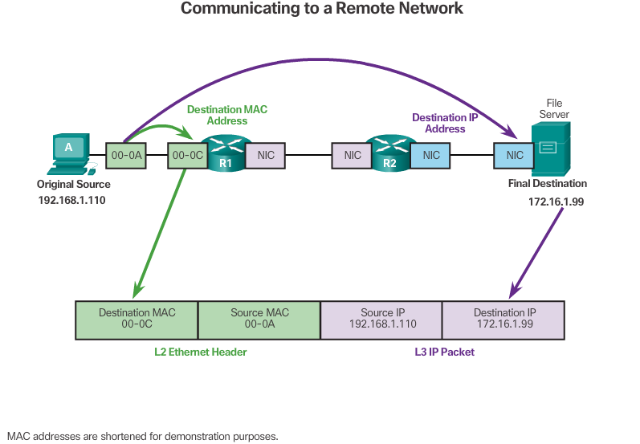
Destination on a Remote Network
Notes:
5.3.1.2 Destination Remote Network
5.3.1.3 Packet Tracer – Identify MAC and IP Addresses

Slide 5
Topic 5.3.2: ARP

Slide 6
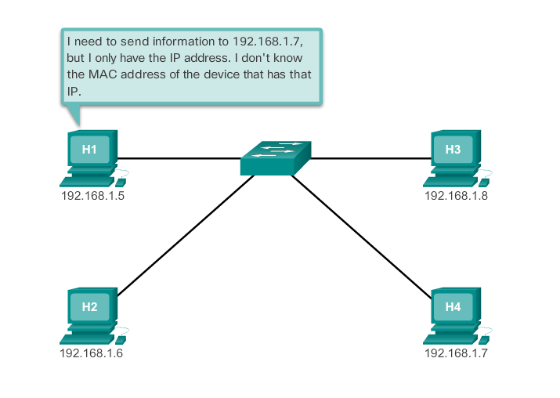
Introduction to ARP
Notes:
5.3.2.1 Introduction to ARP

Slide 7
ARP Functions
ARP Table
Used to find the MAC address that is mapped to the destination IPv4 address.
If the destination IPv4 address is on the same network as the source IPv4, the device will search the ARP table for the destination IPv4 address.
If the destination IPv4 address is on a different network, the device will search for the IPv4 address of the default gateway.
If the device locates the IPv4 address, its corresponding MAC address is used as the destination MAC address in the frame.
If no entry is found, then an ARP request is sent.
Notes:
5.3.2.2 ARP Functions

Slide 8
ARP Request
Sent when a device needs a MAC address associated with an IPv4 address, and it does not have an entry in its ARP table.
The ARP request message includes:
Target IPv4 address – This is the IPv4 address that requires a corresponding MAC address.
Target MAC address – This is the unknown MAC address and will be empty in the ARP request message.
The ARP request is encapsulated in an Ethernet frame using the following header information:
Destination MAC address – This is a broadcast address requiring all Ethernet NICs on the LAN to accept and process the ARP request.
Source MAC address – This is the sender’s MAC address.
Type – ARP messages have a type field of 0x806.
See VIDEO DEMONSTRATION
Notes:
5.3.2.3 Video Demonstration - ARP Request

Slide 9
ARP Reply
The device with the target IPv4 address in the ARP request will respond with an ARP reply. The ARP reply message includes:
Sender’s IPv4 address – This is the IPv4 address of the sender, the device whose MAC address was requested.
Sender’s MAC address – This is the MAC address of the sender, the MAC address needed by the sender of the ARP request.
The ARP reply is encapsulated in an Ethernet frame using the following header information:
Destination MAC address – This is the MAC address of the sender.
Source MAC address – This is the sender of the ARP reply’s MAC address.
Type – ARP messages have a type field of 0x806.
See VIDEO DEMONSTRATION
Notes:
5.3.2.4 Video Demonstration - ARP Reply

Slide 10
Video Demonstration – ARP Role in Remote Communication
When the destination IPv4 address is not on the same network as the source IPv4 address, the source device needs to send the frame to its default gateway.
The source checks its ARP table for an entry with the IPv4 address of the default gateway.
If there is not an entry, it uses the ARP process to determine the MAC address of the default gateway.
See VIDEO DEMONSTRATION
Notes:
5.3.2.5 Video Demonstration – ARP Role in Remote Communication

Slide 11
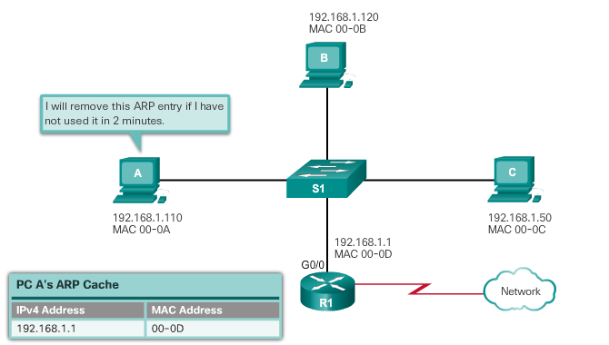
Removing Entries from an ARP Table
ARP cache timer removes ARP entries that have not been used for a specified period of time.
Commands may also be used to manually remove all or some of the entries in the ARP table.
Notes:
5.3.2.6 Removing Entries from an ARP Table

Slide 12
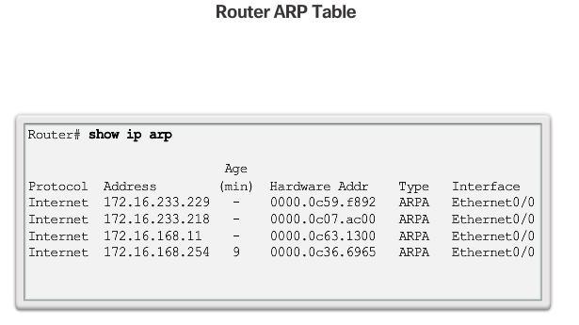
ARP Tables on Networking Devices
Notes:
5.3.2.7 ARP Tables on Networking Devices

Slide 13
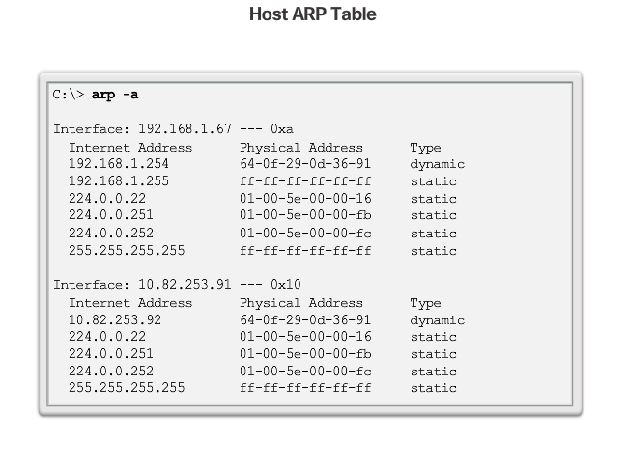
ARP Tables on Networking Devices (cont.)
Notes:
5.3.2.7 (Cont.) ARP Tables on Networking Devices
5.3.2.8 Packet Tracer - Examine the ARP Table

Slide 14
Topic 5.3.3: ARP Issues

Slide 15
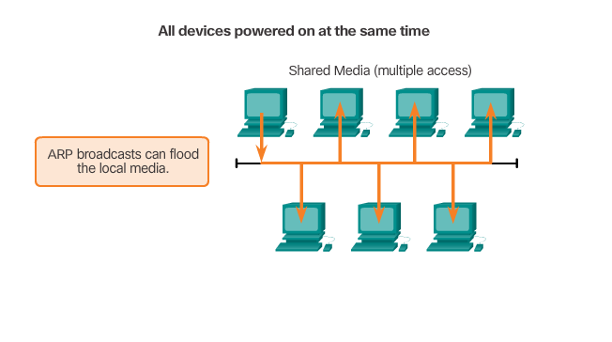
ARP Broadcasts
Notes:
5.3.3.1 ARP Broadcasts

Slide 16
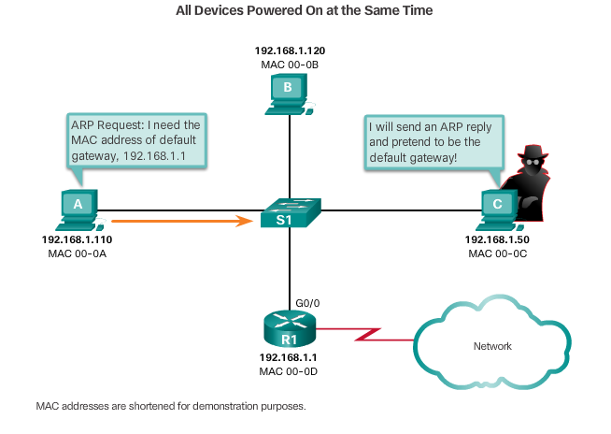
ARP Spoofing
Notes:
5.3.3.2 ARP Spoofing

Slide 17
Section 5.4: Summary
Chapter Objectives:
Explain the operation of Ethernet.
Explain how a switch operates.
Explain how the address resolution protocol enables communication on a network.
Notes:
5.4.1.1 Class Activity - MAC and Choose…
5.4.1.2 Chapter 5: Ethernet

